Slide 1

Analysis of Life Expectancy Factors
Ian Housman
Darlene Ko
TJ Jaramillo
Thai Nguyen

Slide 2
Motivation and Considerations
Motivation: To draw conclusions on the factors that influence the average life expectancy age.
Considerations:
  What is the overall trend of the average global life expectancy from 2000 to 2014 and which of the developed vs. developing countries had the highest and lowest life expectancies?
  How does the social factor (Schooling) affect life expectancy in developed vs. developing countries?
  How does the lifestyle factor (Alcohol) affect life expectancy in developed vs. developing countries?
  Which of the developed vs. developing countries has the highest adult mortality?
  How does the economic factor (Income Composition of Resources) affect life expectancy in developed vs. developing countries?
Purpose: We chose these questions based upon the research that we conducted.

Slide 3
Summary Findings
Overall, we were able to answer some of our initial questions. However, we experienced some challenges along the way, and we had to modify our questions based on the dataset.
Our initial findings were as follows:
  The overall trend for life expectancy improves year-over-year in both developed and developing countries. As expected, developed countries had a higher life expectancy.
  Schooling has a high correlation to life expectancy in developing countries.
  Alcohol consumption is correlated to life expectancy in developing countries and not as much in developed countries.
  Adult mortality rates were much higher in developing countries than developed and were due to different causes depending on the country’s development status.
  The average income composition of resources is highly correlated to countries’ life expectancies, more so than any other factor presented in our data.

Slide 4
Research & Dataset
Dataset sourced from Kaggle but the original raw data was collected from the World Health Organization (WHO) and United Nations websites.
193 Countries Represented from 2000 to 2015
Out of the 193 Countries, 32 were Developed and 161 were Developing.
The features included immunization factors, mortality factors, economic factors, social factors and other health related factors as listed below:
List of 22 Features
Country | Under-Five Deaths | Polio | GDP
Year | Infant Deaths | Thinness 1-19 yrs | % of Expenditure
Status | HIV/AIDS | Thinness 5-9 yrs | Total Expenditure
Life Expectancy | Diphtheria | Alcohol | Income Resources
Population | Hepatitis B | BMI | Schooling
Adult Mortality | Measles

Slide 5
Data Cleaning & Exploration
Data Cleanup:
  Identified incomplete rows and original shape
  Removed null values
  Verified dropped rows by shape and count
  Determined the data type of each column
  Reorganized column order
  Renamed column headings to remove extra spaces
Data Exploration Process:
  Ran summary statistics
  Plotted Scatterplots for Life Expectancy vs. Each Variable with Correlation Values
  Plotted Boxplots to determine outliers

Slide 6
Data Cleaning & Exploration
Unanticipated Insights during Exploration:
  We did not anticipate that certain features would have no correlation to Life Expectancy (e.g. immunization factors, infant mortality, and total expenditures on healthcare).
Data Issues and Resolutions:
  After exploring the data, we realized that the dataset had partial data for the year 2015. Therefore, we subsequently filtered the data further by excluding the 2 records that had 2015 data.
  Some of the fields were not clearly defined (e.g. BMI), and therefore, we excluded them from our analysis.
Exported Cleaned Dataset to CSV File:
  The cleaned dataset now includes 133 countries from 2000 to 2014.
  Out of the reduced 133 countries, 19 were Developed and 114 were Developing.

Slide 7
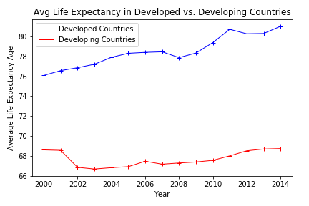
Data Analysis: Question 1a
Question 1a: What is the overall trend of the average global life expectancy from 2000 to 2014 in developed vs. developing countries?
STEPS:
  Separate data into 2 data frames, group by Developed & Developing Countries.
  Calculate the Average Life Expectancy for each country over the 14 years of data from each data frame.
  Plot 2 lines in the same figure to show the trend over time.

Slide 8
Data Analysis: Question 1b
Question 1b: Which of the developed vs. developing countries has the highest and lowest life expectancies?
STEPS:
  Separate data into 2 data frames, group by Developed & Developing Countries.
  Calculate the Average Life Expectancy for each country over the 14 years of data from each data frame.
  Print the Top 5 and Bottom 5 Developed & Developing Countries.
Top 5 Developed | Bottom 5 Developed | Top 5 Developing | Bottom 5 Developing
Ireland = 83.44 | Bulgaria = 72. 74 | Canada = 82.23 | Sierra Leone 48.43
Italy = 82.15 | Lithuania = 72.75 | France = 82.21 | Lesotho = 48.61
Spain = 82.02 | Latvia = 73.67 | Greece = 81.23 | Zimbabwe = 49.39
Australia = 81.91 | Romania = 73.99 | Israel = 81.22 | Malawi = 50.26
Sweden = 81.90 | Poland = 75.53 | Chile = 79.94 | Angola = 50.68

Slide 9
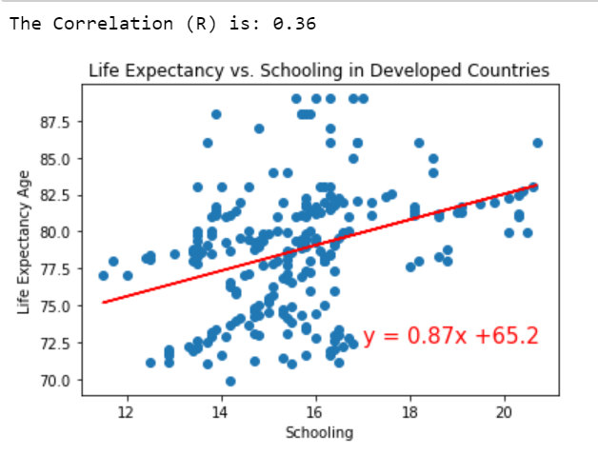
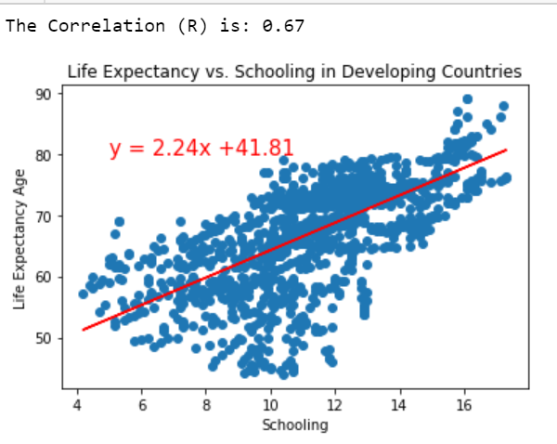
Data Analysis: Question 2
Question 2: How does the social factor (Schooling) affect life expectancy in developed vs. developing countries?
STEPS:
  Separate data into 2 data frames, group by Developed & Developing Countries.
  Calculate the Average Life Expectancy and Average Schooling for each country over the 14 years of data from each data frame.
  Plot the averages in separate scatter plots and add linear regression models.

Slide 10
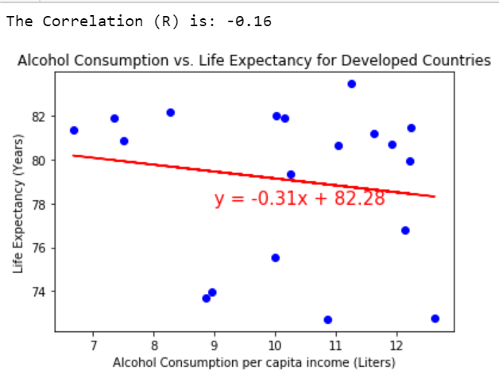
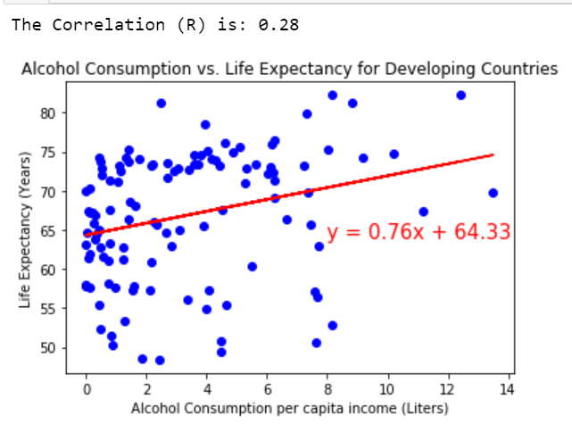
Data Analysis: Question 3
Question 3: How does the lifestyle factor (Alcohol) affect life expectancy in developed vs. developing countries?
STEPS:
  Separate data into 2 data frames, group by Developed & Developing Countries.
  Calculate the Average Life Expectancy and Average Alcohol for each country over the 14 years of data from each data frame.
  Plot the averages in separate scatter plots and add linear regression models.

Slide 11
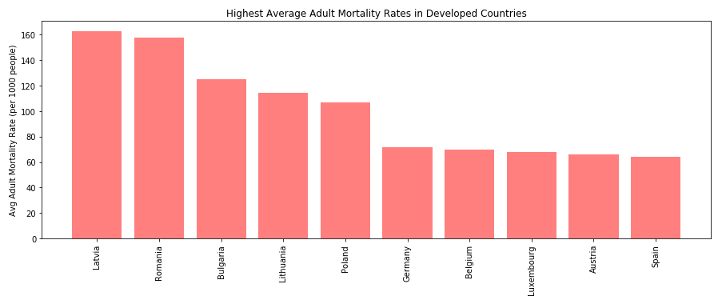
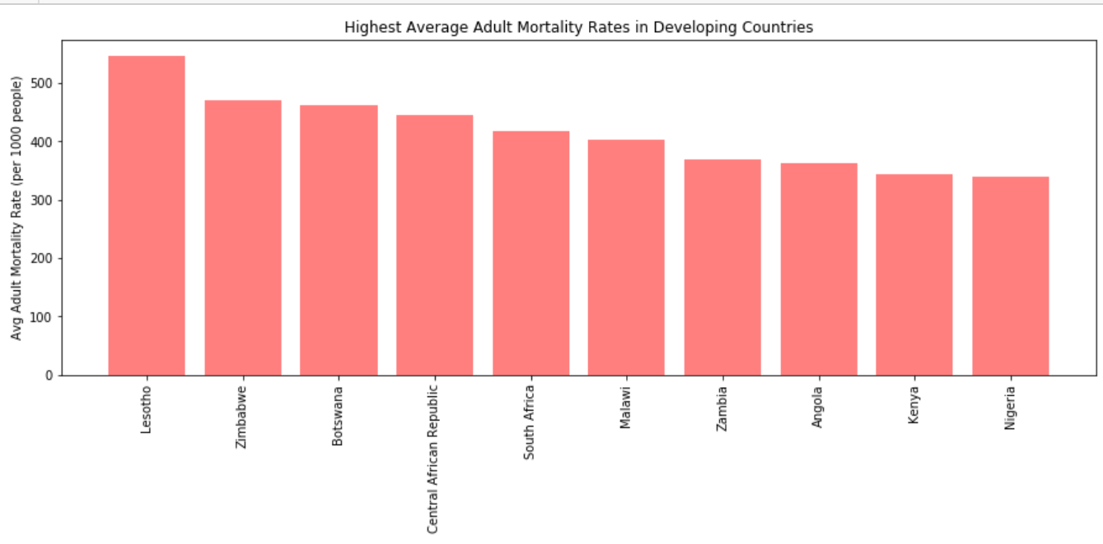
Data Analysis: Question 4
Question 4: Which of the developed vs. developing countries has the highest adult mortality?
STEPS:
  Separate data into 2 data frames, group by Developed & Developing Countries.
  Calculate the Average Adult Mortality Rate for our Developed and Developing countries and sort each data frame by highest to lowest mortality.
  Plot the averages in separate scatter plots and add linear regression models.

Slide 12
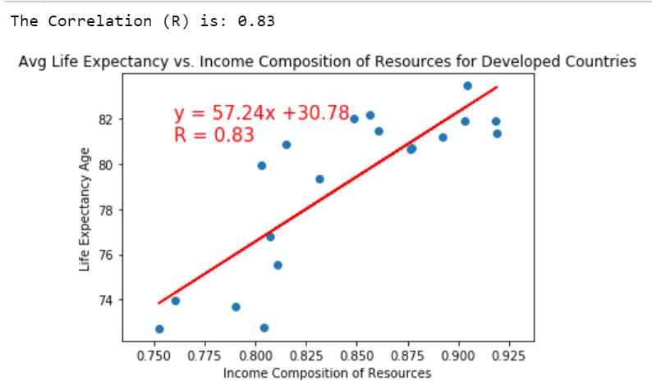
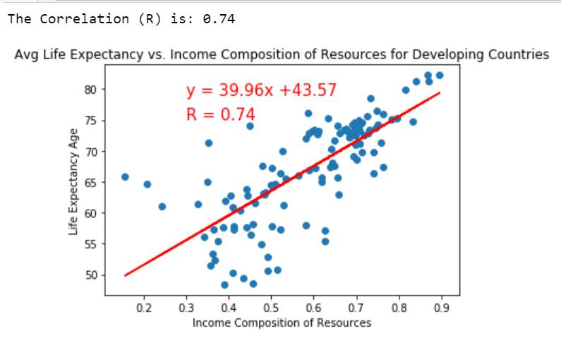
Data Analysis: Question 5
Question 5: How does the economic factor (Income Composition of Resources) affect life expectancy in developed vs. developing countries?
STEPS:
  Separate data into 2 data frames, group by Developed & Developing Countries.
  Calculate the Average Life Expectancy and Average Income Composition of Resources for each country over the 14 years of data from each data frame.
  Plot the averages in separate scatter plots and add linear regression models.

Slide 13
Conclusions/Discussion
Overall Life Expectancy Trend:
  The overall Life Expectancy is gradually increasing over time in both Developed and Developing countries.
  On average, from 2000 to 2014, people living in Developed Countries have a life expectancy by 10.83 years higher than those living in Developing Countries.
General Observations:
  The data may be skewed because there are more records for developing countries than developed countries.

Slide 14
Conclusions/Discussion
Social Factor (Schooling):
  It was not expected that Schooling has an overall strong positive correlation. However, Schooling has a much stronger correlation of 0.67 in Developing Countries than a fair correlation of 0.36 in fully Developed Countries. This could indicate that funding for schools should be a primary focus when considering the improvement of health in developing countries.
Lifestyle Factor (Alcohol):
  Alcohol consumption trends show a very slight negative correlation to Life Expectancy for Developed countries, and a small positive correlation for Developing countries.
  Because Developed countries have access to better healthcare, the relation between Alcohol consumption and Life Expectancy is expected to be subtle.
  Whereas the positive correlation for the Developing countries may be explained by the large gap in wealth among the wealthier class and general population. If one can afford healthcare in a Developing country, they can also afford alcohol. Similarly, the population that cannot afford to drink often would logically not be able to afford healthcare, which may be why we see a positive correlation there.

Slide 15
Conclusions/Discussion
Mortality Factor (Adult):
  As expected, the mortality rate in developing countries is much higher than that in developed countries.
  When looking at the developing and developed countries with the highest mortality rates, we find that the top causes of death are different.
  In developing countries most adult mortality is due to communicable diseases with HIV/AIDS being most prevalent.
    This is most likely why we see a strong positive correlation between quality of schooling and life expectancy in developing countries since reducing transmission of HIV is vastly reliant on educating on how this disease is transmitted.
  In developed countries most mortality is due to non-communicable diseases with heart disease being most prevalent.

Slide 16
Conclusion/Discussion
Economic Factor (Income Composition of Resources):
  Out of all factors in our dataset, we found that the economic factor had the strongest correlation to a country’s life expectancy. With a correlation factor of 0.83 in developed countries and 0.74 in developing countries, we could likely estimate a country’s life expectancy based on their Income Composition of Resources.
  There is a positive correlation between life expectancy and income for both developed and developing countries meaning that the more income people make the longer they can expect to live because they will have easier access to appropriate healthcare.
  People from developed countries tend to spend more on healthcare than people from developing countries, making their average life expectancy higher than those living in developing countries.

Slide 17
Post Mortem
Challenges:
  Finding good reliable data that is sufficiently large enough with consistent format
  Dataset was either incomplete and/or the features were not clearly defined (e.g. BMI)
Resolutions:
  We switched topics based on the dataset that we could find.
  We modified our questions and eliminated analysis that was inconclusive.
Further Research with Additional Time:
  Further research with updated information through 2019 and complete information from the countries that we excluded because of null values (e.g. United States).
  Determine if different Health Care Systems by Country have an impact on Life Expectancy, and if so, what type of health care systems are most effective (Universal, Private, a combination of Universal and Private, etc.).

Slide 18
Q&A
Open-floor Q&A with the audience

